Slide 1
數位電路導論
Introduction to Circuits Theory and Digital Electronics
梁 勝 富
成功大學 資訊工程系
sfliang@mail.ncku.edu.tw
Office: 雲平東棟 416R, Tel: Ext. 62549
Lab:神經運算與腦機介面實驗室
(雲平東棟 301R, Tel: 62530-74)
http://ncbci.csie.ncku.edu.tw/

Slide 2
課程概述
Circuits
  Introduction
  Basic RLC Circuit Theory
  Frequency Response
Electronics
  Diodes
  Fidel-Effect Transistors
Digital Systems
  Logic Circuits

Slide 3
參考書目與評分標準
參考書目:
  “Electrical Engineering: Principles and Applications”, Allan Hambley, 6th edition, Pearson, 2014.
評分標準:
  Presence 10%, Assignment 30%, Midterm Exam. 30%, Final Exame. 30%

Slide 4
課程相關資訊
課程網頁
  http://ncbci.csie.ncku.edu.tw/
Office hour：
  Wed., 13:30~15:30
  Office:雲平東棟 416R. Tel: 62549
  Lab:雲平東棟 301R, Tel: 62530-74
助教
  雲泰傑：denny61302@gmail.com
  林家宏：jiahonglin17@gmail.com

Slide 5
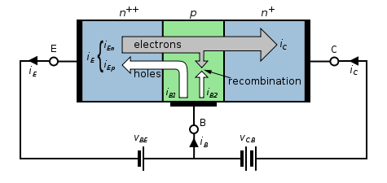
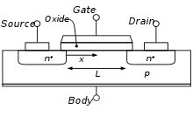
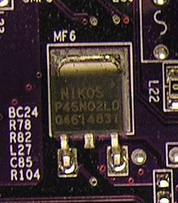
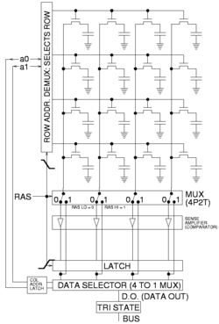
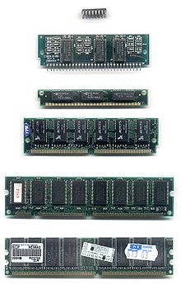
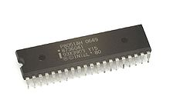
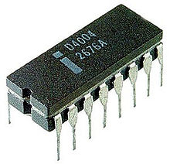
Evolution of Semiconductor Technology
1940-1950
  Bipolar Transistor
1950-1960
  MOSFET
  CMOS
1960-1970
  DRAM
1970-1980
  Microprocessor
(Figures are from wiki)

Slide 6
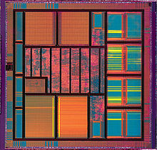
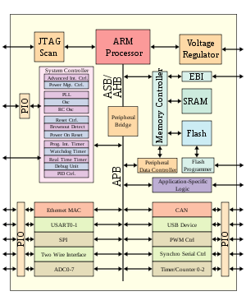
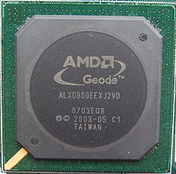
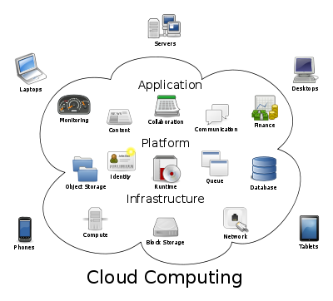
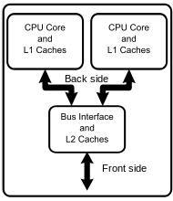
Evolution of Semiconductor Technology
1980-2000 (VLSI)
  Personal Computer (x86, Pentium)
  uP+Memory
2000-2013 (SoC)
  Internet
  DSP+Analog
  Multi cores
  Cloud computing
(Figures are from wiki)

Slide 7
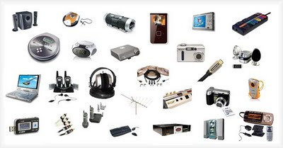
Applications of Electronics and Circuits
Consumer Electronics
(http://www.deadzones.com/2010/12/must-have-consumer-electronics-for-2011.html)

Slide 8
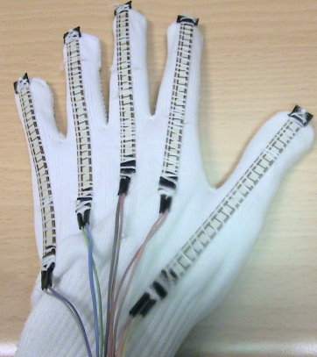
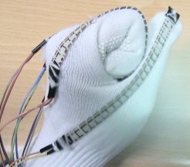
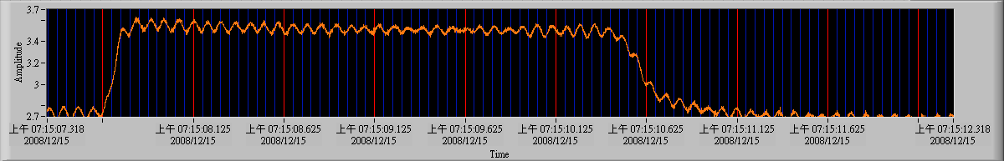
Applications of Electronics and Circuits
Human Computer Interface-Flex Sensor
手攤平(手指彎曲度最小)
手握拳(手指彎曲度最大)

Slide 9
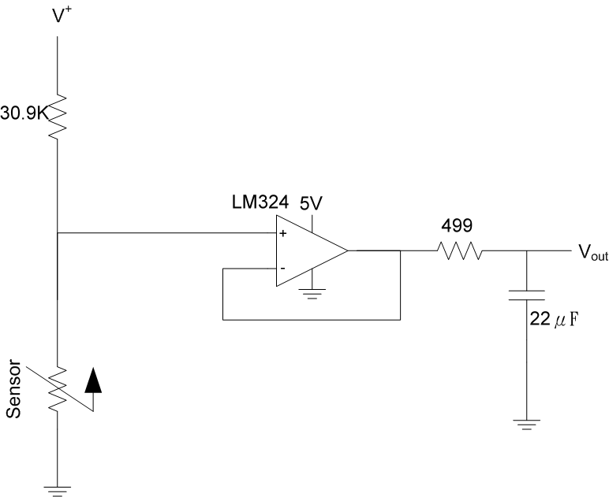
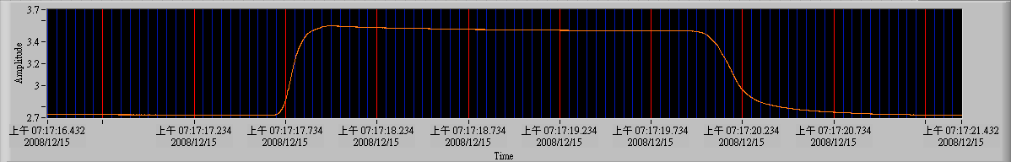
Applications of Electronics and Circuits
Human Computer Interface-Flex Sensor
Low Pass Filter

Slide 10
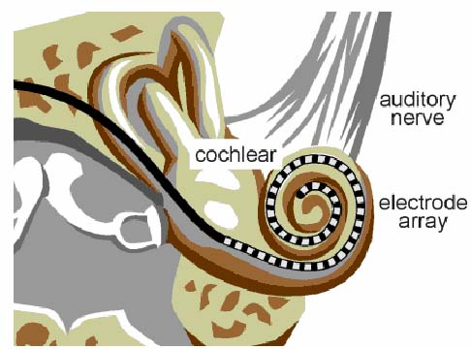
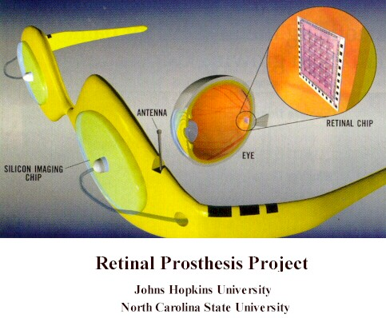
Applications of Electronics and Circuits
Neuroprosthesis (神經彌補裝置)
Retina implants (電子眼)
Cochlear implants (電子耳)

Slide 11
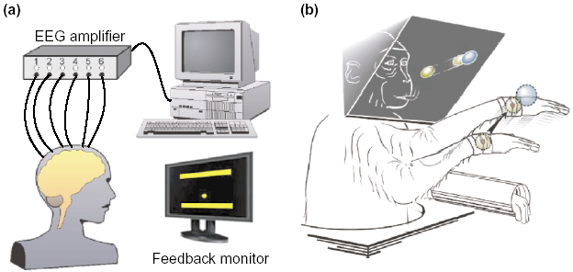
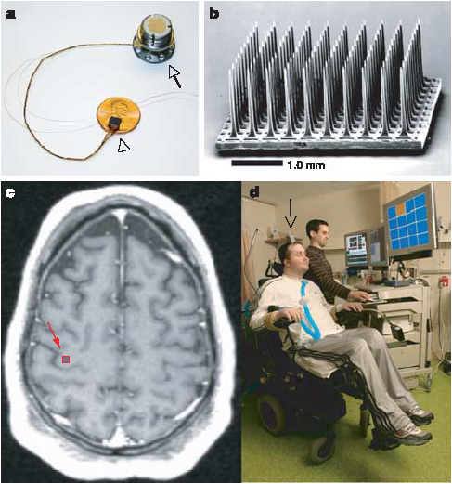
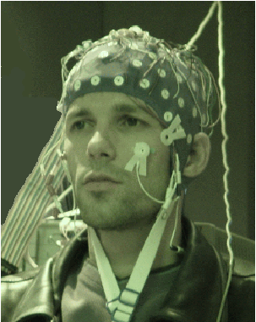
Applications of Electronics and Circuits
Brain Computer Interface (腦機介面)

Slide 12


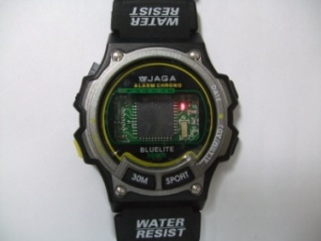
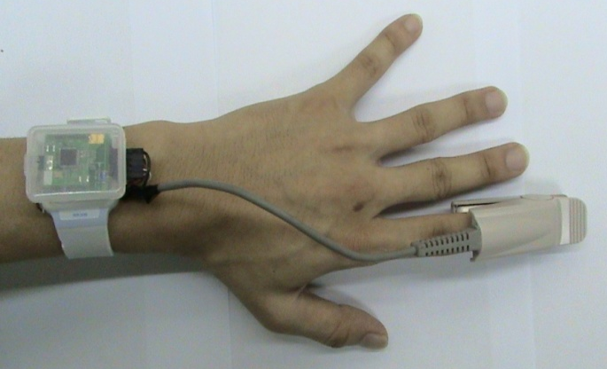
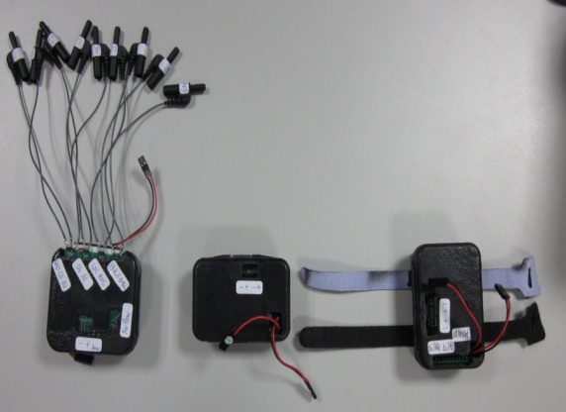
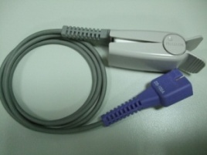
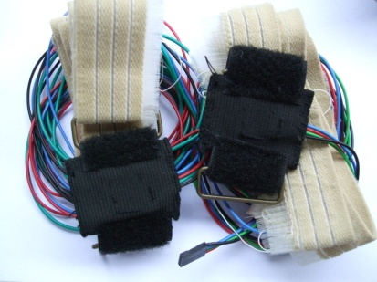
Applications of Electronics and Circuits
Health Care Devices-Developed by NCBCI, NCKU
睡眠紀錄錶
血氧心率紀錄錶
多重睡眠生理記錄儀

Slide 13
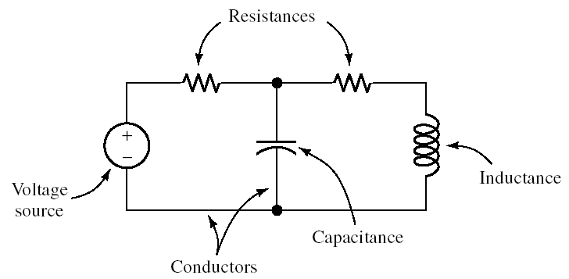
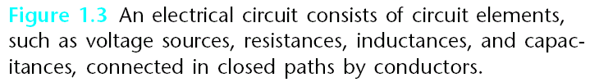
What We Will Learn?
Circuit Elements

Slide 14
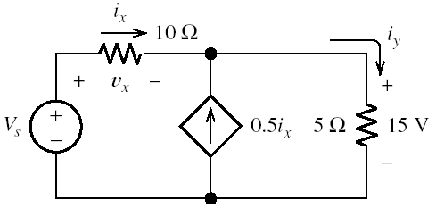
Using KVL, KCL, and Ohm’s Law to Analyze a Circuit
What We Will Learn?
Circuit Analysis

Slide 15
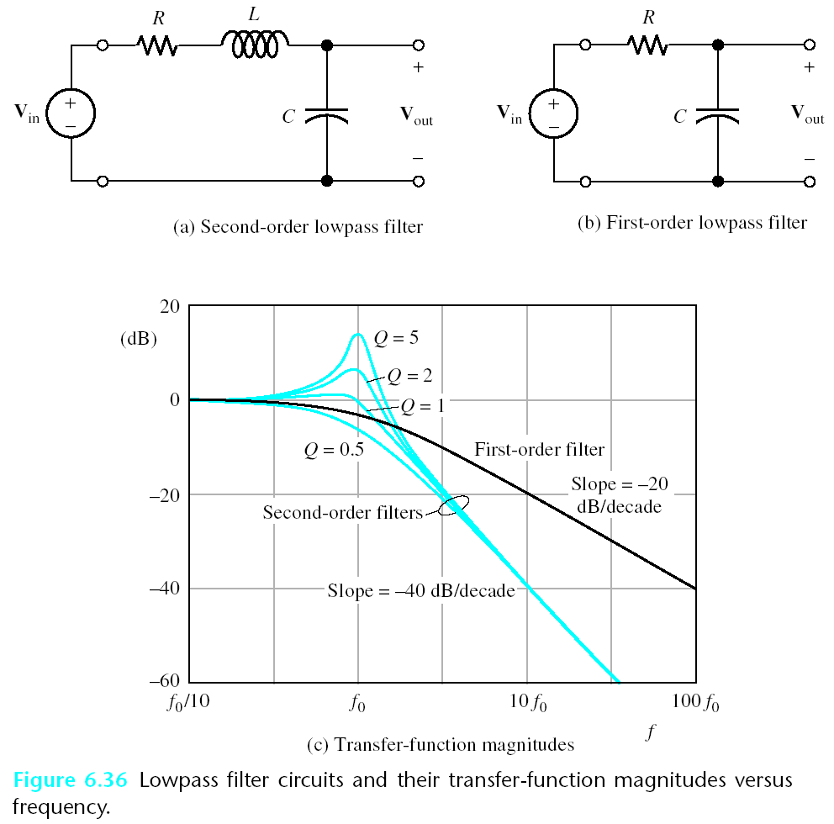
What We Will Learn?
Filter and Frequency Response

Slide 16
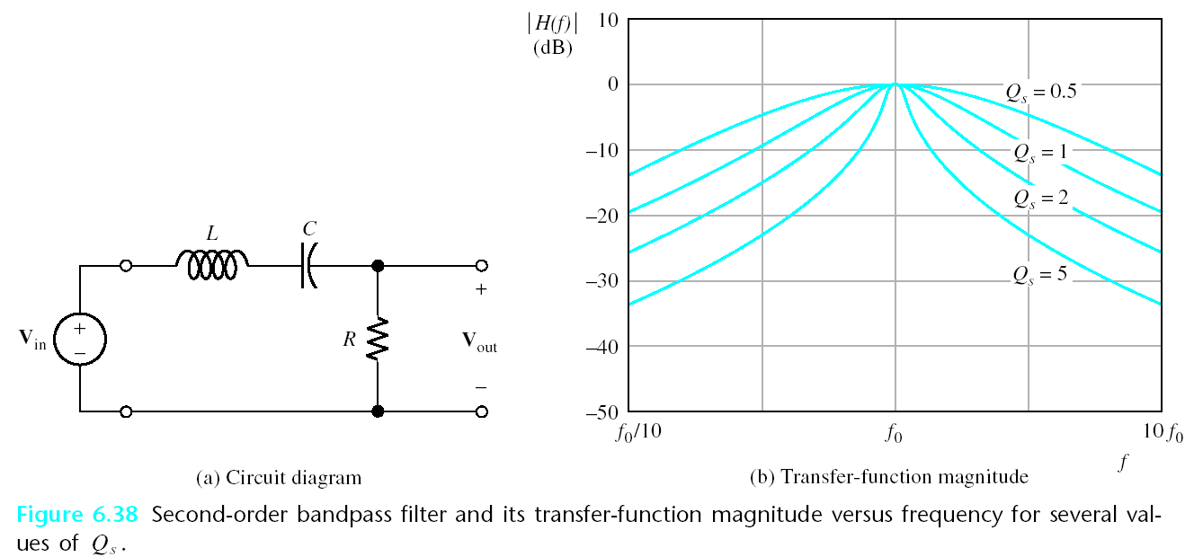

Slide 17
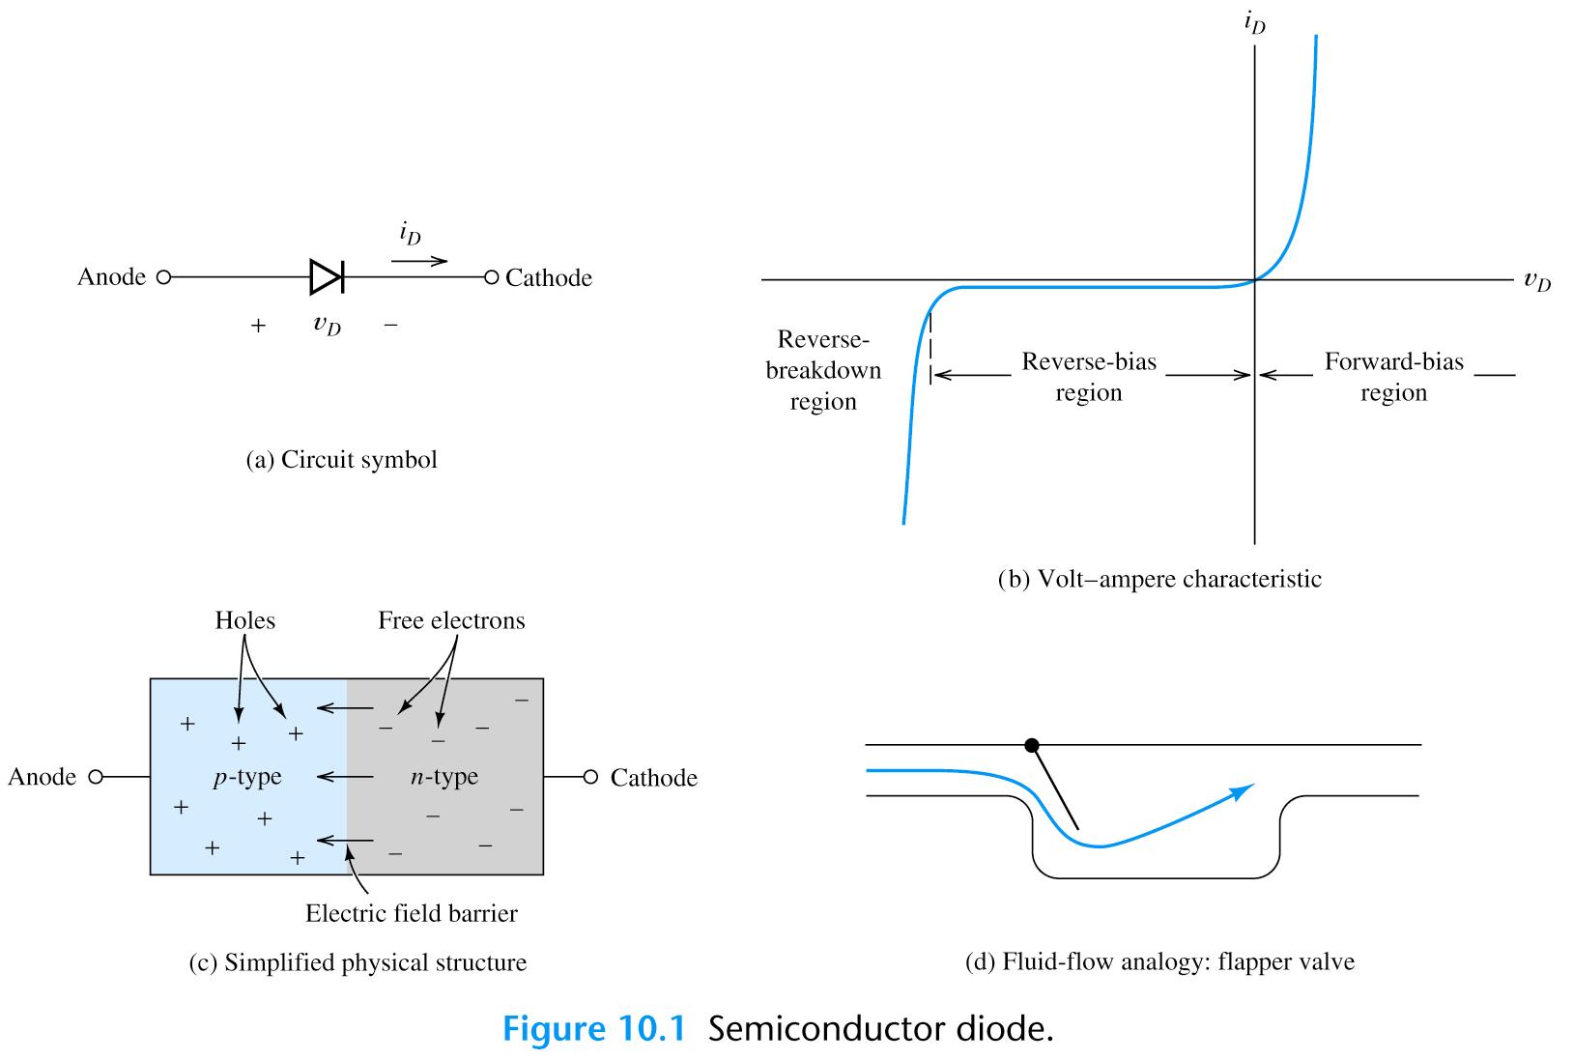
What We Will Learn?
Electronics

Slide 18
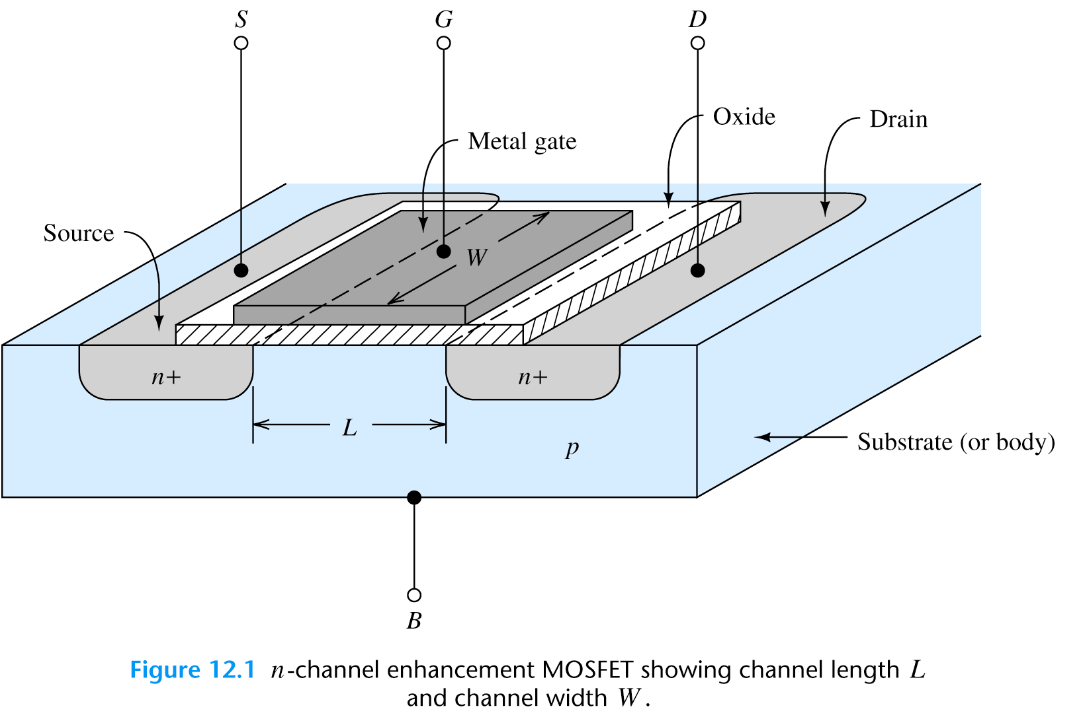

Slide 19
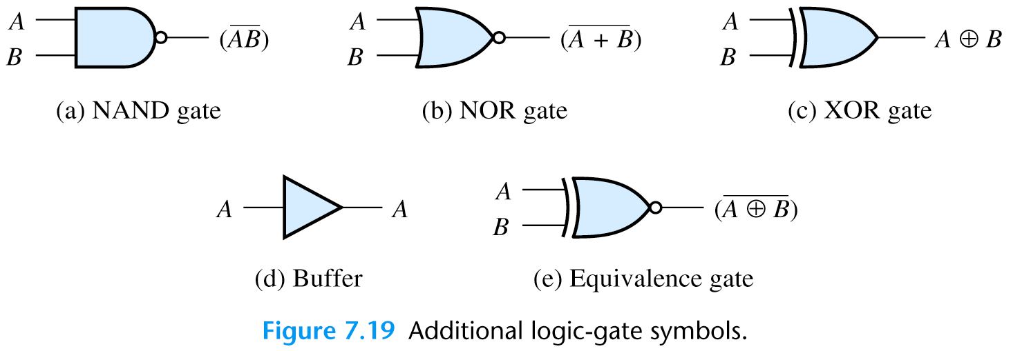
What We Will Learn?
Digital Systems

